Slide 1
Measuring Trees
Ecology: Carbon

Slide 2
Measuring carbon storage

Slide 3
We need to calculate the amount of carbon in the tree.
For this we need to measure –
Diameter
Height

Slide 4
Measuring tree diameter
Wrap your measuring tape around the tree to measure its circumference, approximately 1.4 meters above the ground.
Use the equation d = c/π
d = diameter
c = circumference
π = 3.14

Slide 5
Sample datasheet
Tree | c circumference (cm) | d diameter (cm)
1
2
3
4

Slide 6
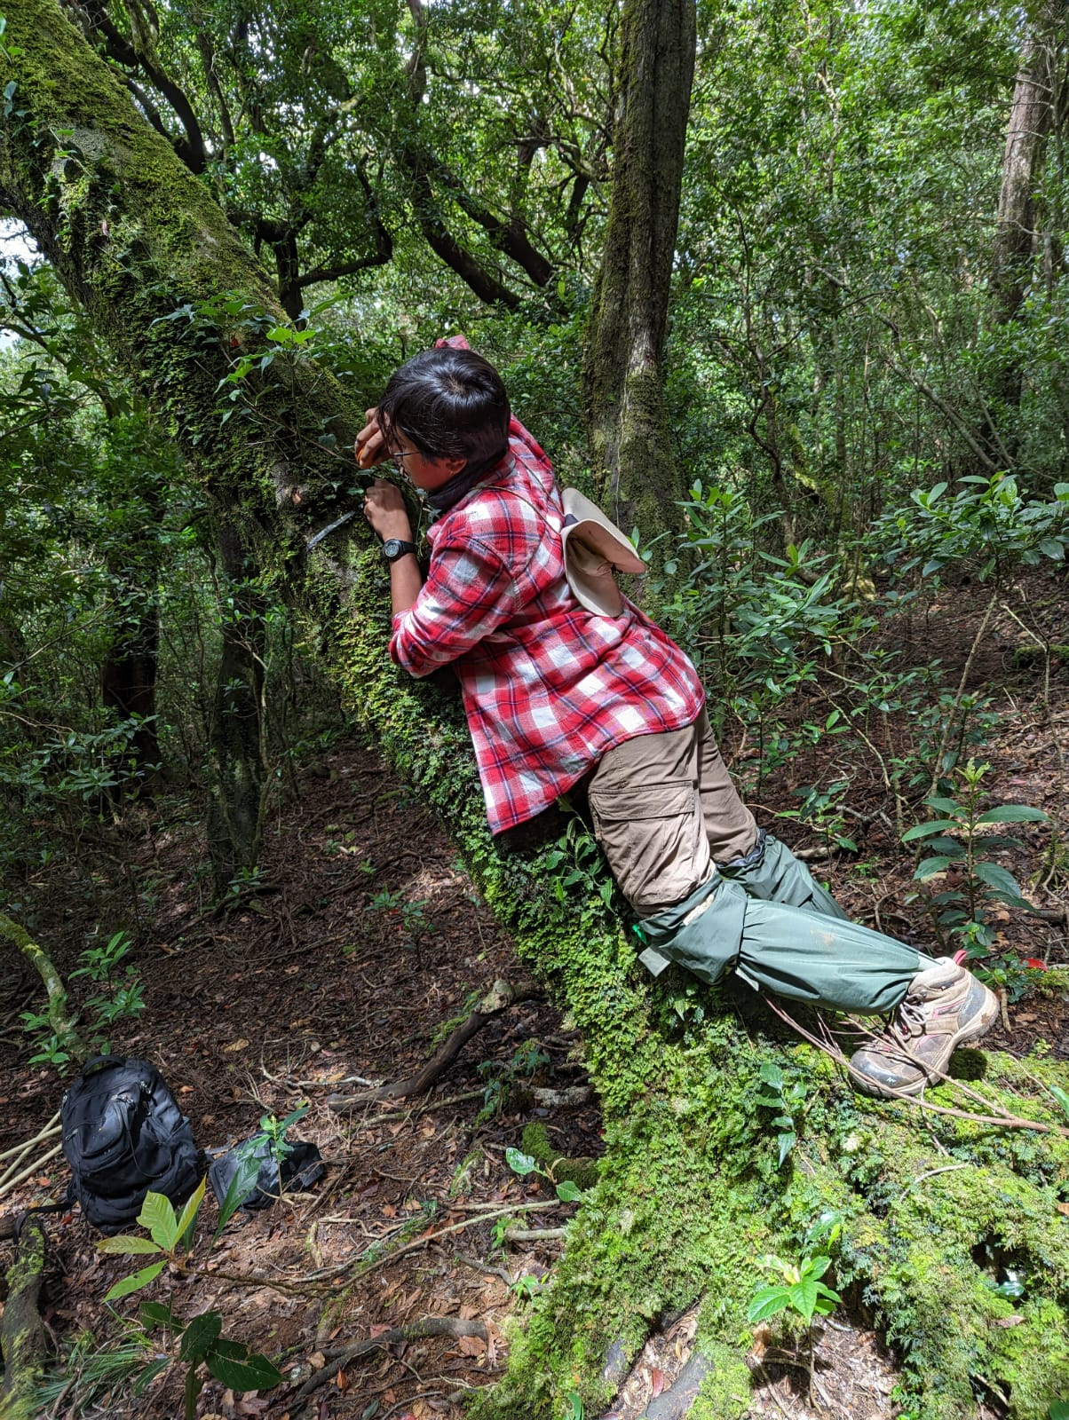
How to measure circumference

Slide 7
How NOT to measure circumference

Slide 8
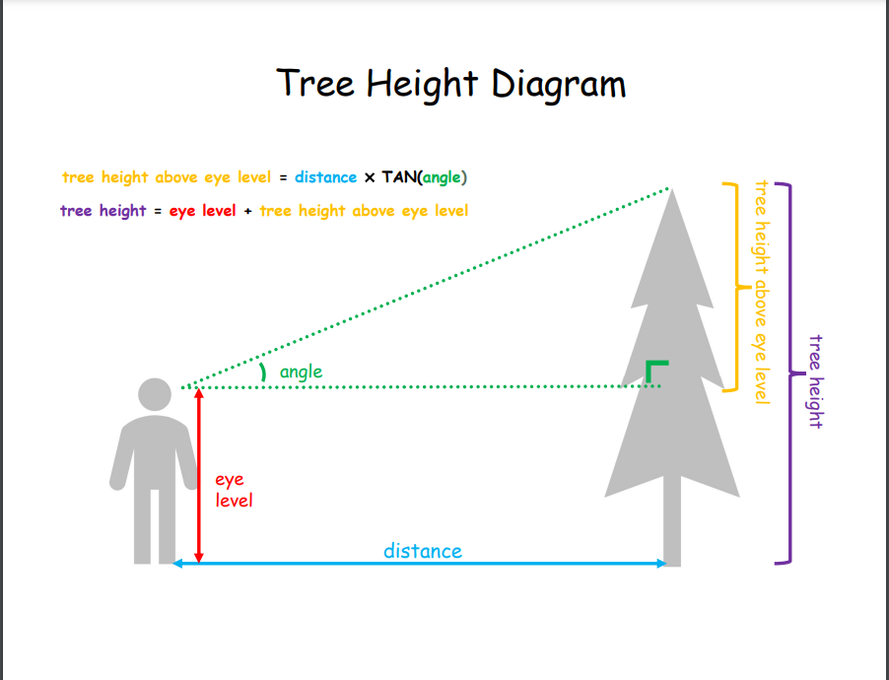
Measuring height
Some people have curly black hair turn permanent black

Slide 9
Sample datasheet
Tree | Height (m)
1
2
3
4

Slide 10
Calculating green weight (GW)
The green weight of a tree is an estimate of the mass of the tree when it is alive
All wood content + any moisture in the tree
If d < 28, GW = 0.0577 x d x d x h
If d >= 28, GW = 0.0346 x d x d x h

Slide 11
Calculating dry weight (DW)
Researchers have estimated that the average tree is 50% dry weight.
So, DW = GW x 0.5

Slide 12
Calculating average carbon content
Average carbon content is generally 50% of the tree’s total volume.
So, average weight of carbon = 0.5 x DW

Slide 13
Calculating weight of CO2 in the tree
CO2 is composed of one molecule of carbon and 2 molecules of Oxygen.
Atomic weight of Carbon = 12.00115
Atomic weight of Oxygen = 15.9994
Weight of CO2 is C + 2xO = 43.999915
Ratio of CO2 to C = 43.999915/12.001115 = 3.663
Weight of carbon in the tree = 0.5 x 3.6663 x DW

Slide 14
Sample datasheet
Tree | Green weight (GW, kg) | Dry weight (kg) | Carbon content (kg)
1
2
3
4

Slide 15
Exercise
If the height of a tree is 15m and the diameter of the tree is 50cm, what is the green weight of the tree?
What is the dry weight?
What is the weight of carbon?
What is the weight of CO2?

Slide 16

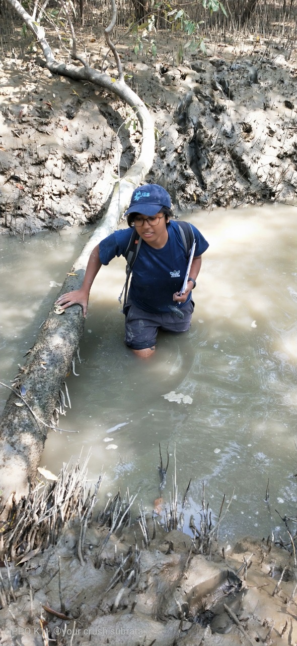
You guys have it easy!

Slide 17
Measuring trees is easy. Getting to the tree you want to measure is the hard part.
“
”
Priyanjana Pramanik

Slide 18
Quantifying Carbon Footprints
Ecology: Carbon

Slide 19
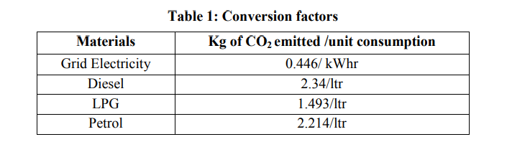
Conversion factors

Slide 20
Thinking about your question
Observations
What did you see/learn that led you to ask this question?
Why are you interested in this question?
Question
What is your research question?
What are the objectives of your project?
Hypotheses
Do you have any hypotheses?
How will you conduct your study? Sampling, datasheets etc.
Study design

Slide 21
Science and Ethics
Ecology

